Slide 1
KIND 360 – Art of the Possible Activation Effectiveness
November 18, 2019

Slide 2
Agenda
Executive Summary
Introduction to Activation Effectiveness Model
Objectives
Scope Summary & approach
Insights
Enhancing and scaling the model
Beyond activation effectiveness
Notes:
Discussion Points:
NL Data
MediaCom Data
AOP Methodology and Scope
Data access – DBP Team
Weekly Tracker Data Upload
Nielsen FTP Credentials

Slide 3

Using the activation effectiveness model, we were able to give specific recommendations for sales directors
EXECUTIVE SUMMARY
In Store execution and Field Marketing events have the most significant impact on sales volume followed by social media ads
Placing KIND products at dual locations in-store drives 2.5x or more volume lift
Field Marketing(free samples of KIND), on an average, drives ~11% volume uplift
Adverts on Twitter, which have the highest viewership, also have the best ROI on media spends
A synergy of promotions during health awareness weeks would drive the highest ROI on our trade investment

Slide 4
Agenda
Executive Summary
Introduction to Activation Effectiveness Model
Objectives
Scope Summary & approach
Insights
Enhancing and scaling the model
Beyond activation effectiveness
Notes:
Discussion Points:
NL Data
MediaCom Data
AOP Methodology and Scope
Data access – DBP Team
Weekly Tracker Data Upload
Nielsen FTP Credentials

Slide 5
What is a activation effectiveness or sales driver model?
An activation effectiveness or sales driver helps us identify which drivers are affecting sales and their elasticity
1. Isolating drivers or activations
Removing seasonal, trend and other noise from the data
2. Attributing the exact effect of each driver on sales
e.g. price elasticities - 1% change in price lead to 4% sales volume lift
3. Accurate demand forecasting
Forecast product demand for different scenarios based on adjusting drivers

Slide 6
Agenda
Executive Summary
Introduction to Activation Effectiveness Model
Objectives
Scope Summary & approach
Insights
Enhancing and scaling the model
Beyond activation effectiveness
Notes:
Discussion Points:
NL Data
MediaCom Data
AOP Methodology and Scope
Data access – DBP Team
Weekly Tracker Data Upload
Nielsen FTP Credentials

Slide 7

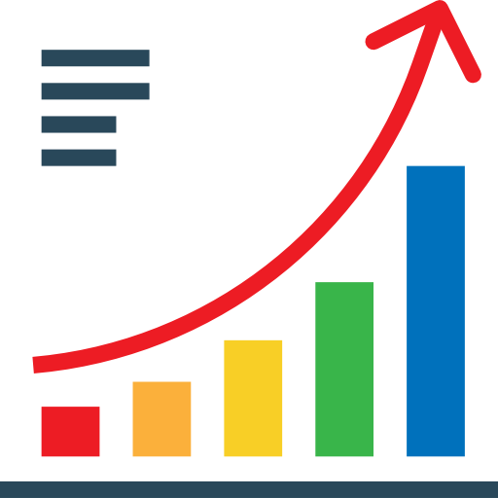


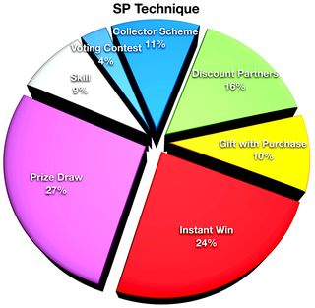



Activation effectiveness aims to answer questions around elasticities of various activations and how to optimize them to increase ROI on investment
Understand how factors like Price, Field Marketing, Sampling strategy is affecting sales/activation
Which factor or driver is affecting my sales the most? How much of an effect will a change in a specific driver of sale bring?
Does having marketing synergy with the value of the week(e.g. the category structural demand or specific events) help boost my sales?
Activation Effectiveness Analysis
Is there an interplay of demand elasticity and field marketing events? Should we focus on marketing events for highly elastic products?
How is distribution and/or promotional distribution(e.g. displays or features) influencing my sales?
How much does sampling affect my sales and which SKUs and stores should I prioritize?
How does social media marketing impact my sales and which platforms have the highest ROI?

Slide 8
Agenda
Executive Summary
Introduction to Activation Effectiveness Model
Objectives
Scope Summary & approach
Insights
Enhancing and scaling the model
Beyond activation effectiveness
Notes:
Discussion Points:
NL Data
MediaCom Data
AOP Methodology and Scope
Data access – DBP Team
Weekly Tracker Data Upload
Nielsen FTP Credentials

Slide 9

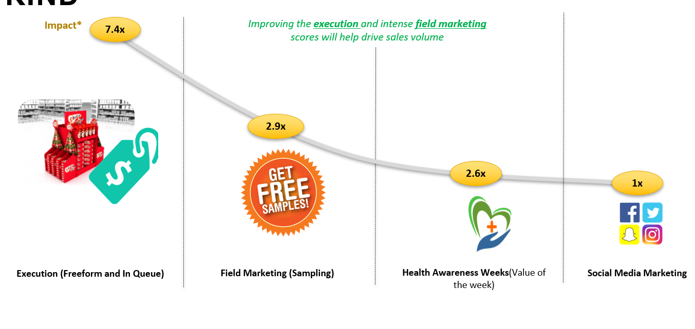
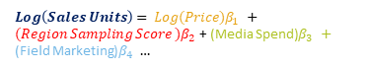
As a pilot assessment, the scope for this was limited to 20 Tesco stores in London, with data from Jan ’19 to July ’19
Tesco Sales
Field Marketing
Media Data
20 stores
Jan to July 2019
Harmonize data
Collate data from multiple files and levels to a standard level
A predictive model using ElasticNet regression algorithm, to understand the effect of activation drivers
Equivalize Sales Volume and Price
EQ factor based std. pack sizes
$Log\left(Sales Units\right)= {Log(Price)β}_{1 }+{(Region Sampling Score )β}_{2 }$+ (Media Spend)$β_{3 }+$
(Field Marketing)$β_{4 }…$
Factor Analysis
Perform factor analysis to understand key factors to go into model
Data Quality Management Layer
Multicollinear Drivers
Identify and treat highly correlated drivers
Analytical Dataset
1
2
3
Create analytical dataset with all drivers*
Engineer Features
Statistical Modeling

Slide 10
Agenda
Executive Summary
Introduction to Activation Effectiveness Model
Objectives
Scope Summary & approach
Insights
Enhancing and scaling the model
Beyond activation effectiveness
Notes:
Discussion Points:
NL Data
MediaCom Data
AOP Methodology and Scope
Data access – DBP Team
Weekly Tracker Data Upload
Nielsen FTP Credentials

Slide 11
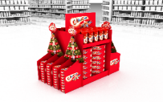


Of the four activations impacting KIND sales, In-store execution and field marketing were found to be the most significant
1
Price Elasticity, In-Store Execution, Field Marketing(Sampling), Value of the week and social media marketing were considered as activations.
2
3
4
In-store execution
Field Marketing (Sampling)
Health Awareness Weeks(Value of the week)
Social Media Marketing
*Due to insignificant variation in prices of KIND products, Price Elasticity was found to be statistically insignificant as an activation

Slide 12
Value of the Week

Slide 13



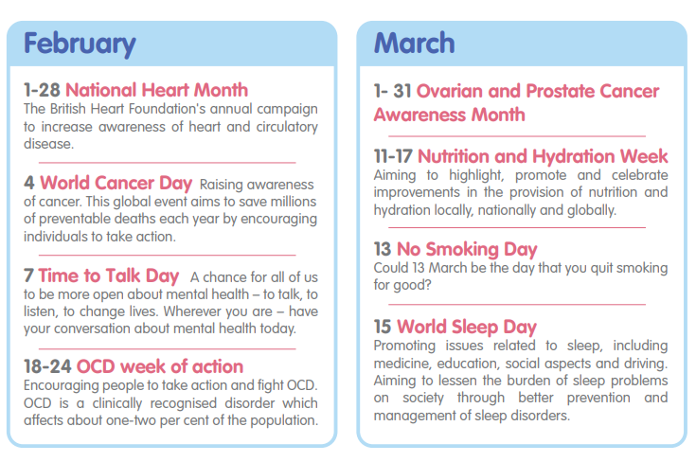
What is value of the week?
Value of the week is the inherent increase/decrease in the demand for a product.
This can be either due to category structural demand or special events like health awareness days.
Category Structural Demand
A value of 1 indicates an average week
Health Awareness Days

Slide 14
KIND products do not seem to follow any category structural demand pattern, with low average sales in high demand weeks and vice versa
Lower sales during high demand period
Higher sales during low demand period
*Category Structural Demand is calculated at a period level
*Peaks correspond to price drops
*Average units across 20 stores at a week level

Slide 15
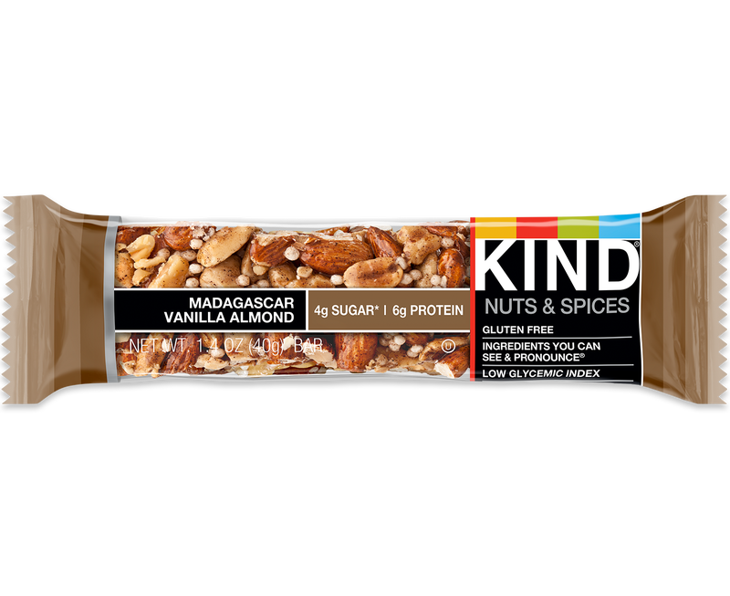
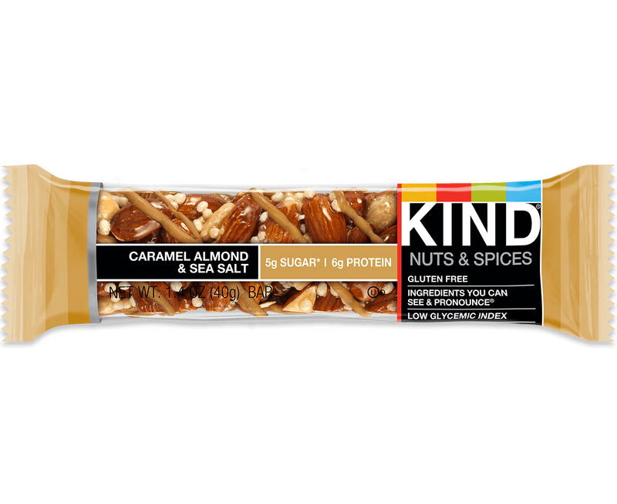
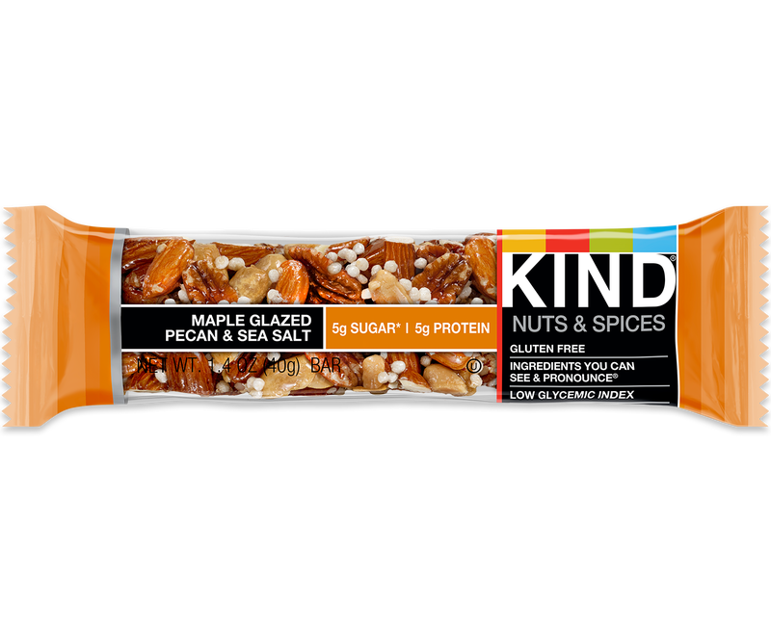
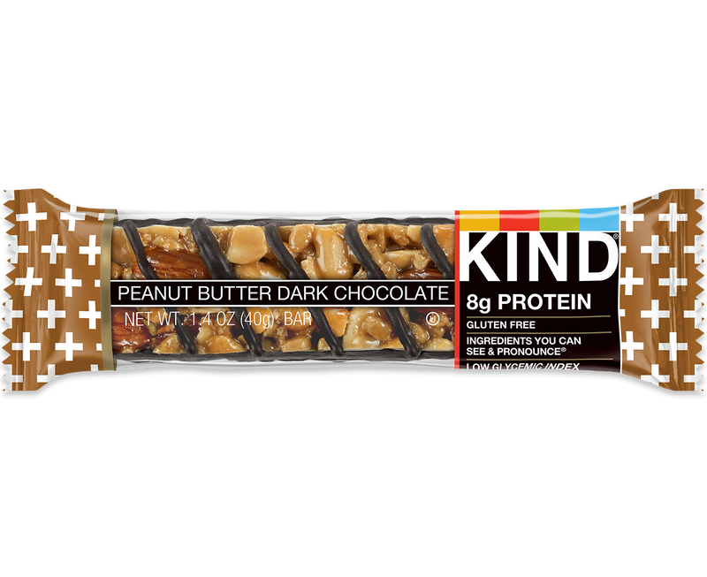
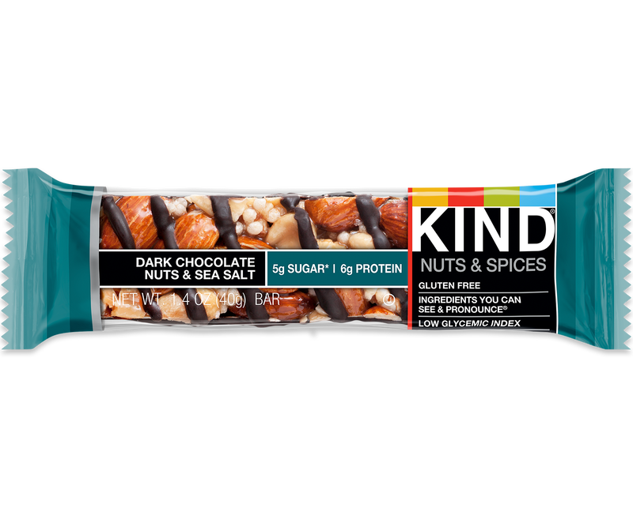
However, they seem to be higher by an average of ~50% during health awareness weeks
We recommend promoting SKUs according to this priority list
Priority
Decreasing effects of promotions during health awareness weeks
1
2
3
4
5
*Health awareness periods are considered to be the following: BNF Healthy Eating Week, Health Information Week, National Obesity Awareness Week, World Health Day and Nutrition Hydration Week

Slide 16
In-store Execution

Slide 17
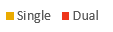
Although all SKU’s respond well to dual placement in-store, Maple Glazed Pecan and Madasgascan Vanilla drive the highest lifts
Execute these SKUs in dual locations to get the highest volume lifts
Peanut Butter & Dark Choc | Dark Choc. Nuts and Sea Salt | Caramel Almond | Madagascan Vanilla & Almond | Maple Glazed Pecan
2.5x
2.8x
3.2x
4.0x
5.8x
*Average units across 20 stores

Slide 18
Sampling(Field Marketing)

Slide 19
Sampling is most effective on Peanut Butter and Madasgascan Vanilla SKUs, with an average volume increase of ~13%
Impact*
18%
17%
14%
12%
Sample SKUs with this priority to get the highest ROI from field marketing
6%
1
2
3
4
5
Priority List
* Percentage Lifts are calculated from baseline
* Priority is based on the impact of sampling on SKUs

Slide 20
We recommend following the prioritization table while sampling SKUs across Tesco Stores to drive maximum volume lift
Priority
1
2
3
4
5
Cheapside Metro | Cheapside Metro | Cheapside Metro | Cheapside Metro | Cheapside Metro
Covent Garden Metro | Regent Street Metro | Bishopsgate Metro | Bishopsgate Metro | Regent Street Metro
Monument Metro | Hammersmith Metro | Hammersmith Metro | Monument Metro | Hammersmith Metro
Bishopsgate Metro | Bishopsgate Metro | Covent Garden Metro | Covent Garden Metro | Bishopsgate Metro
Regent Street Metro | Monument Metro | Regent Street Metro | Hammersmith Metro | Dean Street Metro
1
2
Variability in the way different SKUs drive volume lift across different stores.
3
4
5
* Store names are colour coded arbitrarily
* Only Top 5 stores shown for readability

Slide 21
Social Media Marketing

Slide 22
For every 1M impressions on a social media platform, average sales volume lift is ~5%, while Twitter gives the best ROI across platforms
We recommend using Twitter and Facebook/Instagram as the preferred platforms as they have highest reach/£ ratio
Peanut Butter & Maple Glazed show the highest response to media ads
Highest reach/£ ratio
1
No effect on Madasgascan Vanilla & Almond
2
3
We recommend highlighting “Madagascan vanilla & almond “ and “Caramel Almond” more in media ads to drive higher visibility and sales
* Percentage Lifts are calculated from baseline

Slide 23
Agenda
Executive Summary
Introduction to Activation Effectiveness Model
Objectives
Scope Summary & approach
Insights
Enhancing and scaling the model
Beyond activation effectiveness
Notes:
Discussion Points:
NL Data
MediaCom Data
AOP Methodology and Scope
Data access – DBP Team
Weekly Tracker Data Upload
Nielsen FTP Credentials

Slide 24





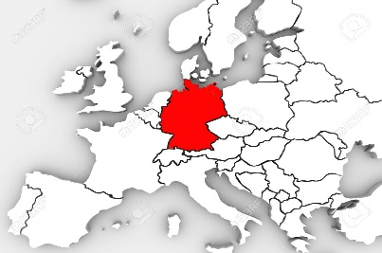

Although the results so far are promising, enriching them with data would enhance the accuracy of our recommendations and insights
New Data Sources
Inclusion of data sources like Nielsen, IRI, etc. to identify additional drivers of sales
Finance data to optimize sales with respect to ROI
What can we do to improve it?
Limitations of current model
Granular data with new metrics
Data at a week level
More metrics like promotional distribution across displays, features and TPRs
Low explain ability – currently can only explain ~50% of the variation in sales
Medium accuracy –only confident about the directionality of insight
All drivers of sales are currently not captured
New customer and geographies
Expand to new markets and customers across same market(UK)
Understand how factors impact sales volume across markets

Slide 25
To improve and scale the model across multiple customers and geographies, the following data is required
Source | Data
Minimum Required data (for 52 weeks)
Nielsen | KIND Sales
Mediacom | Media
Internal | Sampling Data
Internal | Mapping files
Additionally recommended for high confidence insights - (for 104 weeks)
Nielsen | Sales for entire category
Nielsen | Promotional Distribution
Retailer POS | Price points

Slide 26
Agenda
Executive Summary
Introduction to Activation Effectiveness Model
Objectives
Scope Summary & approach
Insights
Enhancing and scaling the model
Beyond activation effectiveness
Notes:
Discussion Points:
NL Data
MediaCom Data
AOP Methodology and Scope
Data access – DBP Team
Weekly Tracker Data Upload
Nielsen FTP Credentials

Slide 27



Over and above the activation effectiveness model, we can leverage advanced analytics for better and faster decision-making
Point of Interest Analysis
and Optimization
Identify which regions are the best for sampling SKUs and optimize the time period and route for field marketing representatives
Social Media Analysis
and Trend Spotting
CustoMER®
Retailer Negotiation Analytics
Identify impact of different media channels and influencers and understand upcoming trends to enhance product portfolio
Plan and negotiate with retailers around displays and in-store execution – forecast category and own volume to get better ROI on trade expenditure

Slide 28
Thank You

